Slide 1
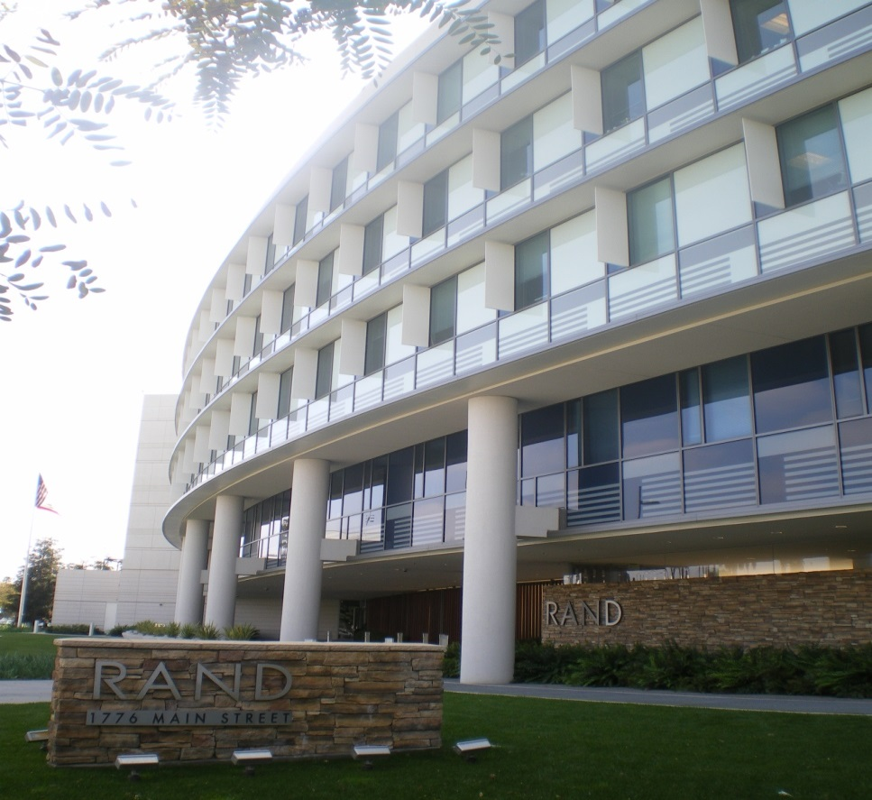
Leaders and Learners:
Research Training and Capacity Building at CIH Institutions through the RAND REACH Center
Moderators:
Patricia M. Herman, ND, PhD
Co-Director, RAND REACH Center
Jennifer Baumgartner, PhD
NCCIH Project Officer, RAND REACH Center

Slide 2
Agenda
Goals for the REsearch Across Complementary and Integrative Health Institutions (REACH) Virtual Resource Centers Program
Overview of the RAND REACH Center
  Dr. Patricia Herman
  Dr. Michele Maiers
  Dr. Ryan Bradley
RAND REACH Center Member Perspectives
  Dr. Monique Aucoin
  Dr. Joshua Goldenberg
  Dr. Steffany Moonaz
Q&A

Slide 3
Goals for the REsearch Across Complementary and Integrative Health Institutions (REACH) Virtual Resource Centers Program
Patricia M Herman (for Jenny Baumgartner, NCCIH Project Scientist)

Slide 4

Primary Research Objectives:
Advance fundamental science and methods development
Advance research on the whole person and on the integration of complementary and conventional care
Foster research on health promotion and restoration, resilience, disease prevention, and symptom management
Cross-Cutting Objectives:
Enhance the complementary and integrative health research workforce
Provide objective evidence-based information on complementary and integrative health interventions
https://www.nccih.nih.gov/about/nccih-strategic-plan-2021-2025
Notes:
Primary Research Objectives:
Advance fundamental science and methods development
Advance research on the whole person and on the integration of complementary and conventional care
Foster research on health promotion and restoration, resilience, disease prevention, and symptom management
Cross-Cutting Objectives:
Enhance the complementary and integrative health research workforce
Provide objective evidence-based information on complementary and integrative health interventions

Slide 5
Rationale for REACH Resource Centers
Research Intensive Institutions
Complementary and Integrative Health Clinical Institutions
Strong research infrastructure and environment
Grantsmanship courses and support
Research training
Interdisciplinary networks
PI’s with history of NIH funding
Lack strong presence of clinician scientists trained in complementary and integrative health disciplines
Faculty include clinician scientists with clinical training to inform research questions
Strong clinical training environment to contribute to knowledge generation
Lack research infrastructure, environment, training, etc to support clinician-scientist careers
Notes:
Patricia -

Slide 6
Structure of REACH Resource Centers
REACH Center
Clinical School A
Clinical School B
Clinical School C
Plans to Expand!
REACH Virtual Resource Center:
Scientific Hubs
Foster institutional partnerships
Support research activities and research training for faculty who work at accredited complementary and integrative health clinical institutions
Provide resources for clinical research aligned with NCCIH strategic priorities for symptom management
Notes:
Patricia -

Slide 7
REACH Resource Center Goals
Improve the quality and quantity of federal research grant applications submitted by clinician scientist faculty at complementary and integrative health institutions
Aid the formation of multi & interdisciplinary partnerships across partnering clinical institutions
Help to enhance the research environment at partnering clinical institutions to expose more students to research
Support a pipeline for clinician scientists to gain expertise in clinical science and pursue research careers at partnering clinical institutions

Slide 8
Overview of the RAND REACH Center
Overview of RAND REACH Center members, staff, and services
Accomplishments over our first 19 months
Patricia M Herman

Slide 9
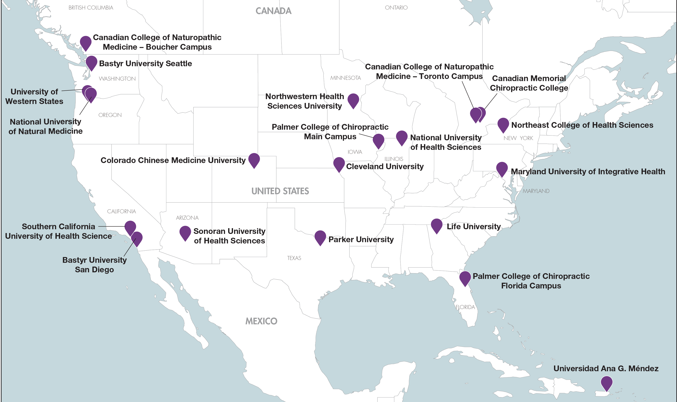
RAND REACH Center Member Institutions
The RAND REACH Center has 17 member institutions with 20 locations across the United States and Canada.
Notes:
Started with 13 member institutions and have added 2 new this year

Slide 10

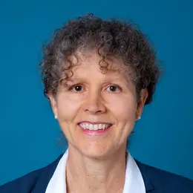
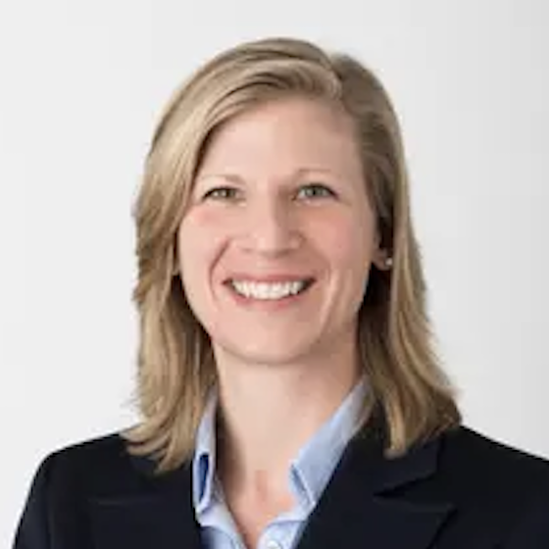
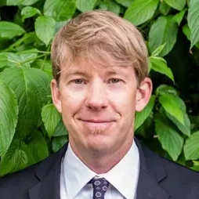
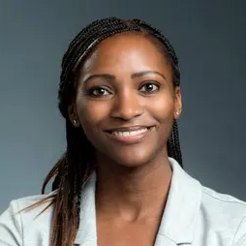


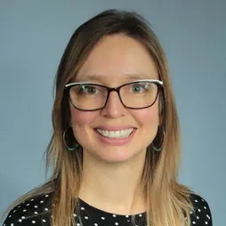
RAND REACH Center Staff
Directors
CODIRECTOR
Ian D. Coulter
Senior Health Policy Researcher
CODIRECTOR
Patricia M. Herman
Senior Behavioral and Social Scientist
CODIRECTOR
Michele Maiers
Executive Director of Research and Innovation, Northwestern Health Sciences University
staff
Donya Avery
Administrative Assistant
Ryan Bradley
Associate Director
Nipher Malika
Associate Policy Researcher
Tiffany Keyes
Policy Analyst
Margaret A. Chesney
Center Advisor
Margaret D. Whitley
Associate Policy Researcher

Slide 11





Overview of the Services Offered by the RAND REACH Center
Services (Partial list; all the result of member requests) | Training | Proposal Process* | Community
Members-only virtual platform | x | x | X
Idea Incubators | x | X | X
RAND Networking sessions | x |  | X
Pilot grants* | x | x | X
Research methods courses | X |  | x
Research methods bootcamps & CITI training | X |  | x
RAND REACH Scholars Program** | X | x | x
Collaboration coordinator |  | X | x
Mock study section reviews | x | X | x
Help desks (Statistics, IRB, grants admin) |  | X
$
*Michele Maiers will cover these in detail in her presentation; **Ryan Bradley will cover this in his.

Slide 12
Highlights from the REACH Center Year 2 (at 19-month point)
Benchmarks from Our Proposal | Yr2 Target | Yr2 to Date | Total to Date
# Attendees to Idea Incubator events per month | 25 | 25 | 25
# Proposals written & submitted (& resubmitted) | 12 | 14 (+4 sched’d) | 30 (+4 sched’d)
Of these, # to federal agencies | 7 | 7 (+4 sched’d) | 12 (+4 sched’d)
Of these, # scored | 3 | 2 of 3 reviewed | 4 of 5 reviewed
Of these, # awarded | 1 | 0 of 3 reviewed | 1 of 5 reviewed
# Non-federal proposals awarded | 2 | 4 | 9
# Partnering institutions on submitted proposals | 7 | 7 | 10
# Partnering institutions that are primary awardees on proposals | 3 | 6 | 6
# New partnering CIH institutions added each year | 2 | 2 | 4
# Publications accepted in peer-reviewed journals each year | 7 | 8 accepted; 1 under review | 13 (1 under review)
Notes:
Patricia -

Slide 13
Highlights from the REACH Center Year 2 (at 19-month point)
Registered Members
Logged in past 6 months
Research Methods Certificate Course
Registered for first course: Foundations of Research Design
Registered for second course: Intro to Statistics
Other Training
Sets of available online workshops/lectures
Have taken advantage of CITI training offered
27
/
12
Presentations/posters by members at national conferences this year
13
11
/
Here at ICIMH!
Notes:
Patricia -

Slide 14
Overview of the RAND REACH Center
Proposal process
Pilot grants
Michele Maiers

Slide 15
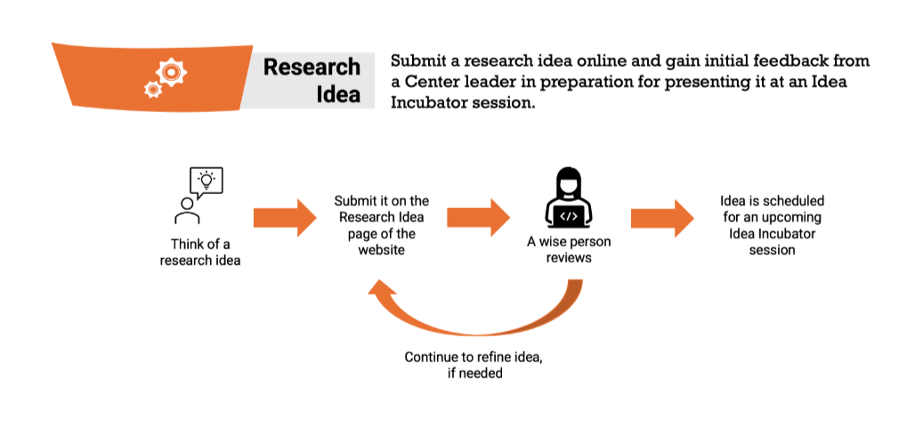
The Research Idea process

Slide 16
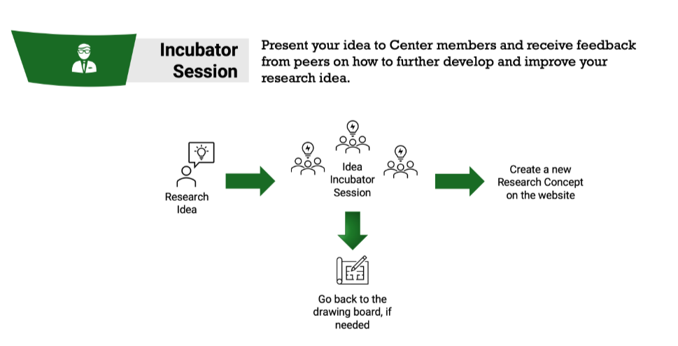
Idea Incubation

Slide 17
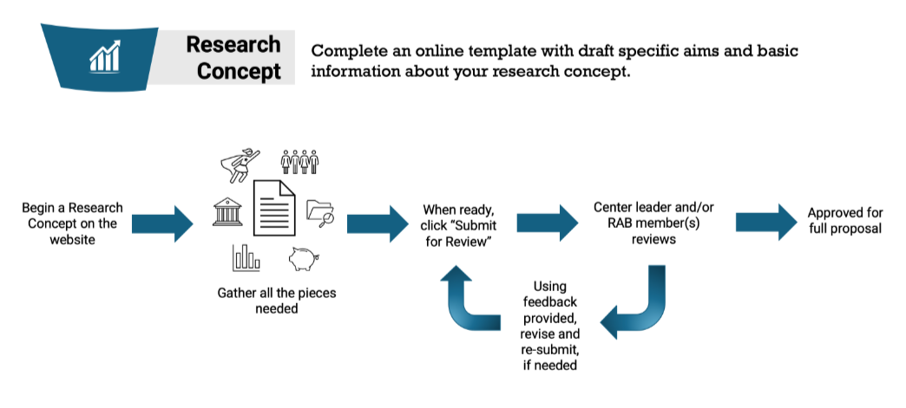
Developing a Research Concept

Slide 18
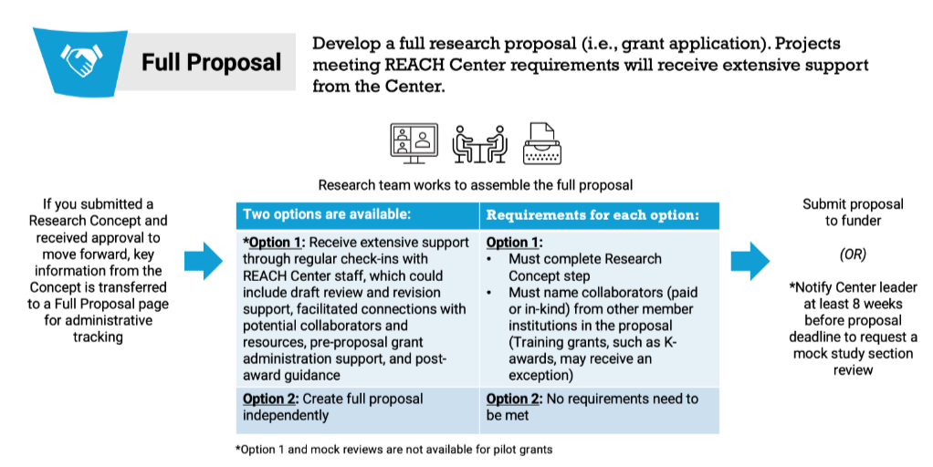
Proposal Support

Slide 19
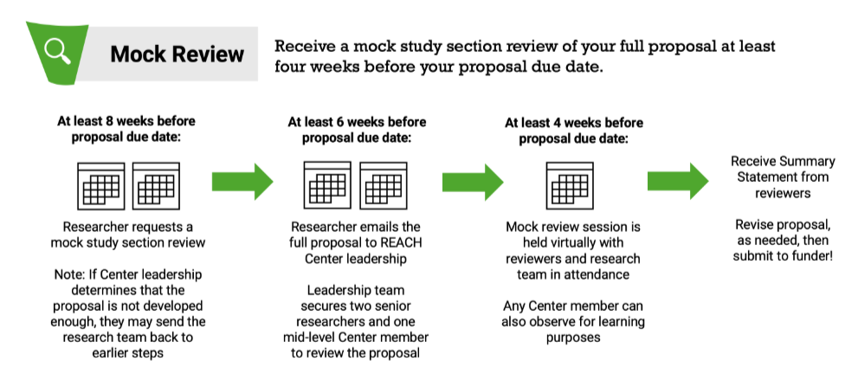
Mock Reviews
Notes:
Proposal Submission Count
Proposals Submitted: 33
Awarded: 16
Under Review: 4

Slide 20
RAND Pilot Research Grants
Parameters
Examples
Funded by NCMIC Foundation
2 year, $15K
Must inform larger research study proposals
Collaborative
Early career researchers
Monthly support
Secondary data analysis; clinic records
Study protocol development
Survey
Literature reviews
Community engagement
Notes:
8/13 (one resubmitted was funded); cycle currently under review (Aug 2023: 2/5; Feb 2024: 3/3; Aug 2024: 3/5)
Examples:
Secondary data—AI to mine narrative fields in ND clinic records
Protocol development—collect patient safety data in DC clinics
Survey—collect cost data alongside diet diary
Lit Reviews—develop mentored program to increase capacity for evidence synthesis via structured reviews of mTBI literature
Community Engagement—FQHC, VA,

Slide 21
Overview of the RAND REACH Center
Overview of the RAND REACH Scholars Program
Ryan Bradley

Slide 22
RAND REACH Scholars Program
Purpose:
  Grow CIH research capacity by learning from RAND research experts, and alongside other CIH colleagues
Goal:
  Provide training to develop CIH clinician scientists

Slide 23
RAND REACH Scholars Program: How does this work?
Structure:
Completely virtual environment
2-year commitment
Fall ’24, ’25, ’26 cohorts
20% effort dedicated to research
Pragmatic approach:
Carefully curated learning content
Network of support
Participatory learning that leads to:
  Proposals
  Collaborations
  Publications

Slide 24
RAND REACH Scholars Program Components
Training:
  “Bootcamp”-style intensive trainings
    Research Methods Bootcamp June 24-28, 2024
  Formal Courses with RAND faculty: Earn a certificate in research from the RAND REACH Center after completing courses learning within a CIH cohort:
    Designing Empirical Research
    Non-experimental Research Design,
    Introduction to Biostatistics,
    Systematic Reviews,
    Scientific Writing, and
    Dissemination & Implementation Science

Slide 25
RAND REACH Scholars Program Components (Cont.)
Research Mentor Team
  Benefit from an individually tailored network of mentors, matched to align with your research interests.
Professional Development Support for your Research Career
  Receive structured assistance to turn your research ideas into successful grants, projects, and publications.
  Discuss career aspirations & strategy
  Extend collaborative network

Slide 26
Current RAND REACH Scholars
Andrea Albertson, DC: Northwestern Health Sciences University
  Interest area: Assessing CIH Contributions in FQHCs
Monique Aucoin, ND, MSc: Canadian College of Naturopathic Medicine
  Interest area: Nutritional Approaches to Anxiety
Jocelyn Faydecko, ND, DC: National University of Health Sciences
  Interest area: Gamified Behavioral Interventions to Support Family Physical Activity
Alaa Gerais, ND: Sonoran University of Health Sciences
  Interest area: Regenerative Medicine
Joshua Goldenberg, ND, PhD(cand.): National University of Natural Medicine
  Interest area: Evidence-synthesis, Traumatic Brain Injury
Maranda Kleppe, DC: Palmer College of Chiropractic
  Interest areas: D&I, pain phenotyping, predictors of outcomes
Meghan Mackey, DC: Parker University
  Interest area: Optimizing Treatment for Spinal Stenosis
Maya Roth, ND: Bastyr University California
  Interest area: Practice Outcomes using EHR Data
Carol Ann Weiss, DC, MSc: Canadian Memorial Chiropractic College
  Interest area: Women’s Health
Nicole Zipay, DC: Parker University
  Interest areas: musculoskeletal ultrasonography, and contextual effect of language used in discussing imaging results

Slide 27
RAND REACH Center Member Perspectives
Experience in the RAND REACH Scholars Program & with a pilot grant
Monique Aucoin

Slide 28

Expertise to Advance a Research Project
EASe-GAD pilot study
What is the impact of these dietary recommendations on the cost of food?
Expertise in Cost Evaluation
Pilot process underway
Strengthen funding application for subsequent study

Slide 29

Benefits
Inter-institutional collaboration
Research Methods & Stats training: fill in knowledge gaps, confidence
Mentorship
Opportunity to consult an expert

Slide 30
RAND REACH Center Member Perspectives
Experience in RAND REACH Scholars, with a pilot grant, and increasing his professional network
Joshua Goldenberg

Slide 31
Opening Doors and Mindsets
Expanded network of researchers
Access to very high level investigators
High quality mentorship
Exposure to new ideas and ways of thinking about problems – benefiting from the experience of others

Slide 32
Community
“Forced” collaboration
Expanding beyond just my ND peers
Joint writing group
Mutual support
“We’re all in this together”
Comradery

Slide 33
Resources
Pardee
  Useful coursework without time pressure for busy professionals
  Biostats with R – pragmatic/useful
Pilot
  Neurotrauma Evidence Synthesis Training (NEST) Pilot Program
  Allowed us to build a program and gather preliminary data for an NIH application
  Mock Review before submission
  Feedback on the NIH Feedback
  Support through the full “lifecycle” of a NIH grant application

Slide 34
RAND REACH Center Member Perspectives
Value of the pilot grants and benefits of collaboration
Steffany Moonaz

Slide 35
Overview
Experience with REACH Pilot Funding
RAND REACH support with grant proposals and process
Findings from qualitative research on CIH/R1 collaborations

Slide 36

Online Yoga for Juvenile Idiopathic Arthritis: Stakeholder Survey and Protocol Development
No existing literature in yoga for JIA
In-person yoga infeasible
Vulnerable population
Opportunity for lifelong management
Consideration of R34 but no framework
  CARRA Small Grant
  Rheumatology Research Foundation
  CARRA Large Grant
  RAND REACH Pilot
Will allow stakeholder-informed intervention protocol for future trial
NOTES:
  Insufficient funding requires significant support from home institution
  Constraints on collaborators (R1 subaward, need for CIH institution)

Slide 37
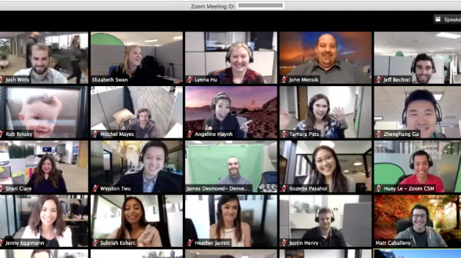

RAND REACH Grant Proposal Support
Feedback during incubator sessions
Mock study sections
Communication with NIH staff
SCU’s first R01 grant ever!

Slide 38
Cross-Sectional Survey Analysis of Institutional Research Partnerships in Complementary and Integrative Health: Identifying Barriers and Facilitators
Research Working Group of Academic Collaborative for Integrative Health (now in AIHM)
Cross-sectional mixed methods survey of CIH and R1 collaborators (goal to include dyads)
Main questions:
  1. How did the CIH institutions successfully initiate and sustain research projects and collaborative relationships with R1 institutions?
  2. How did R1 institutions respond to and maintain collaborative relationships with CIH institutions?
  3. How can the experience from prior collaborations inform future collaborations between CIH and R1 institutions?
Anderson B, Munk N, Moonaz S, Healey D. Cross-Sectional Survey Analysis of Institutional Research Partnerships in Complementary and Integrative Health: Identifying Barriers and Facilitators. J Integr Complement Med. 2024 Dec 9. doi: 10.1089/jicm.2024.0382. Epub ahead of print. PMID: 39648830.

Slide 39
Table 1. Participant Self-Report Descriptors | N=26 (%)
Respondent Institution Type Research Institute Complementary Integrative Training | 2 (7.7) 24 (92.3)
Role in Collaborative Endeavor Administrator Researcher Consultant Liaison Interventionist Statistician Project/Research Design Program Management Publication Author Other* | 13 (50.0) 20 (76.0) 6 (23.1) 4 (15.4) 3 (11.5) 6 (23.1) 14 (53.8) 10 (38.5) 17 (65.4) 2 (7.7)
Represented IH Disciplines in Collaboration Acupuncture Traditional Chinese Medicine Chiropractic Naturopathic Massage Therapy Midwifery Yoga Ayurvedic Other** | 9 (34.6) 6 (23.1) 15 (57.7) 8 (30.8) 5 (19.2) 0 5 (19.2) 0 3 (11.5)

Slide 40
Emergent Themes
Benefits | Challenges
Research Funding, Publications | Lack of CIH Infrastructure, Experience
Knowledge and Experience Acquisition | Institutional Differences in Power and Culture
Strengthened Collaborative Relationship | Credentialing, Regulation of CIH
Relationships, Collegiality, Commitment, Teamwork | Space
Productivity and Increased Opportunities, Outcomes | (R1 Costs)
Institutional Changes, Benefits

Slide 41
Questions?
Please feel free check out our website at www.rand.org/reachcenter
Questions: REACHCenter@rand.org

